Slide 1

SPARKS TO SPEED
The engine’s revolutionary journey

Slide 2
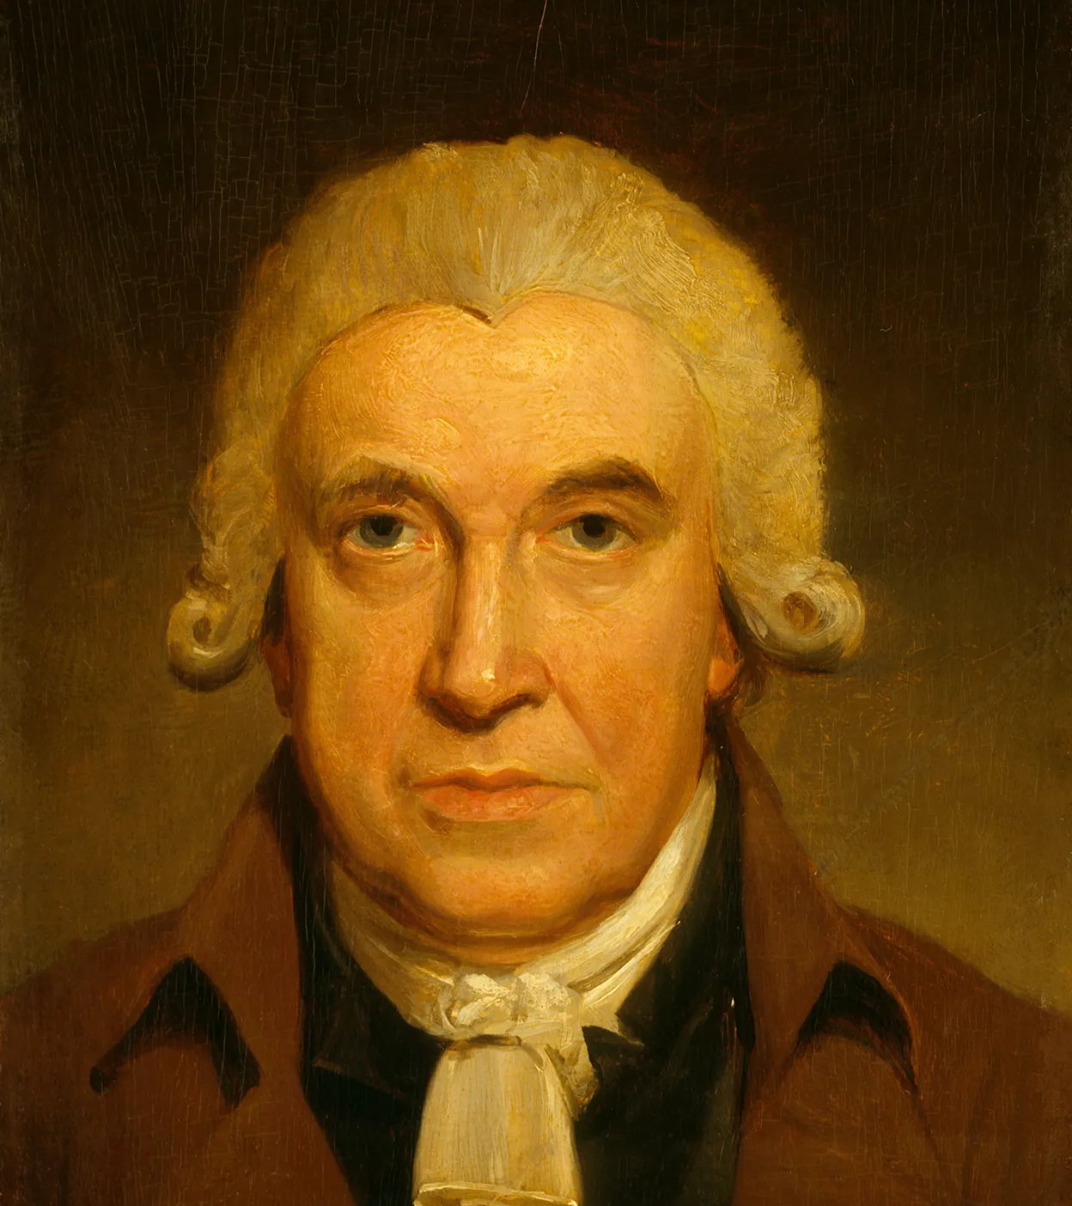
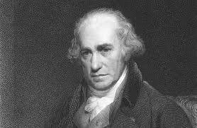
WHO INVENTED ENGINE???
Thomas newcomer invented the engine in 1712.
Later it was improved James watt .

Slide 3
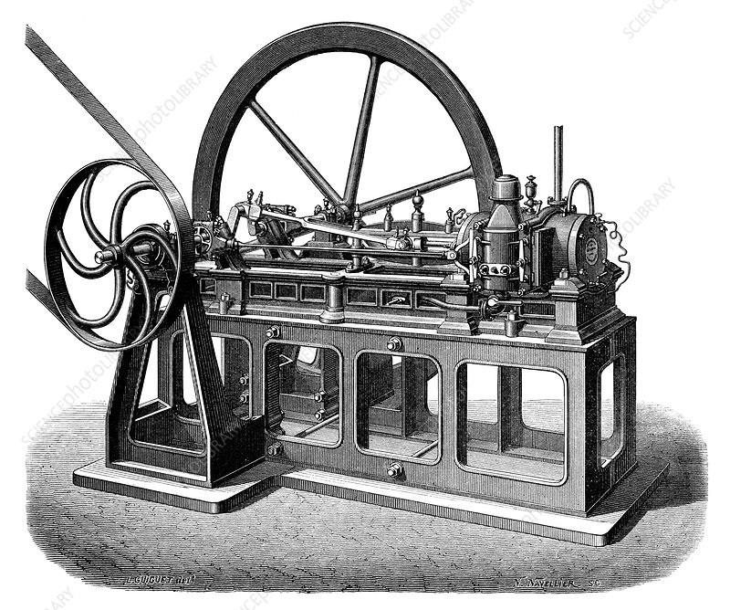
WHAT IS AN ENGINE???
Engine is something that turns electricity in motion.

Slide 4
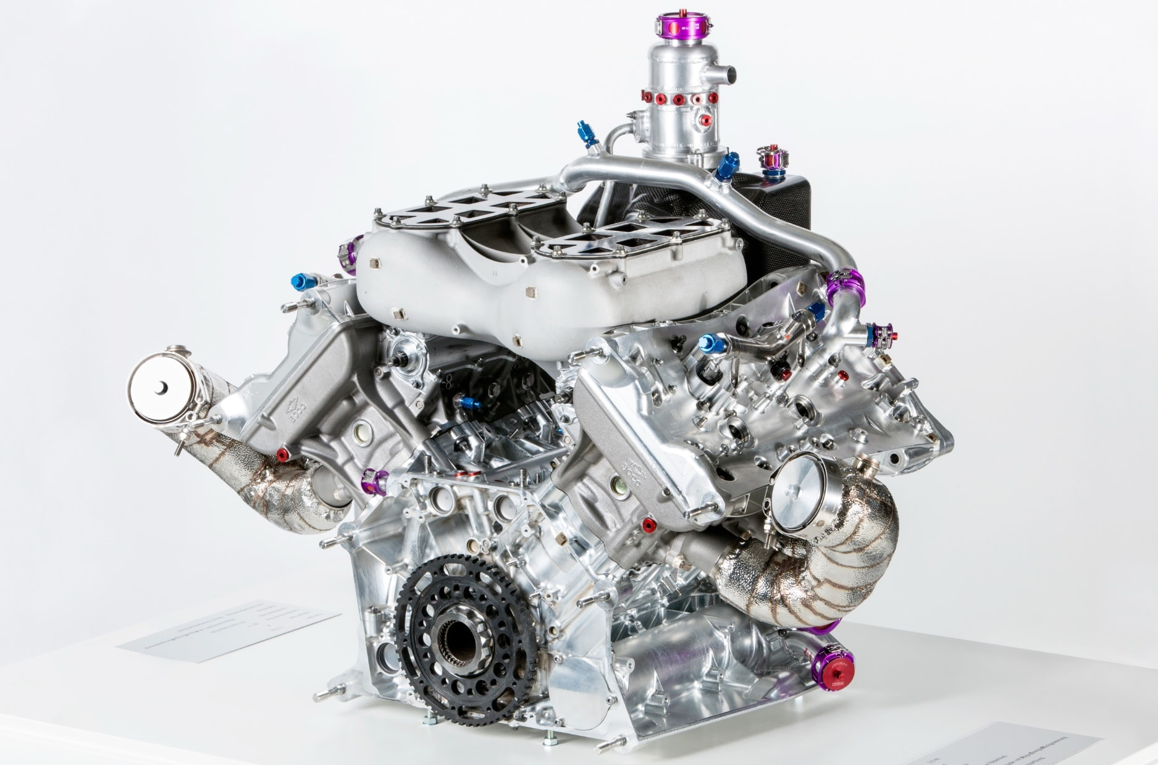
ENGINE: THEN NOW AND FUTURE
Before engine`s where big and slow in working.
Now engine`s are small and fast in working.
In the future there can be eco friendly engine`s.

Slide 5
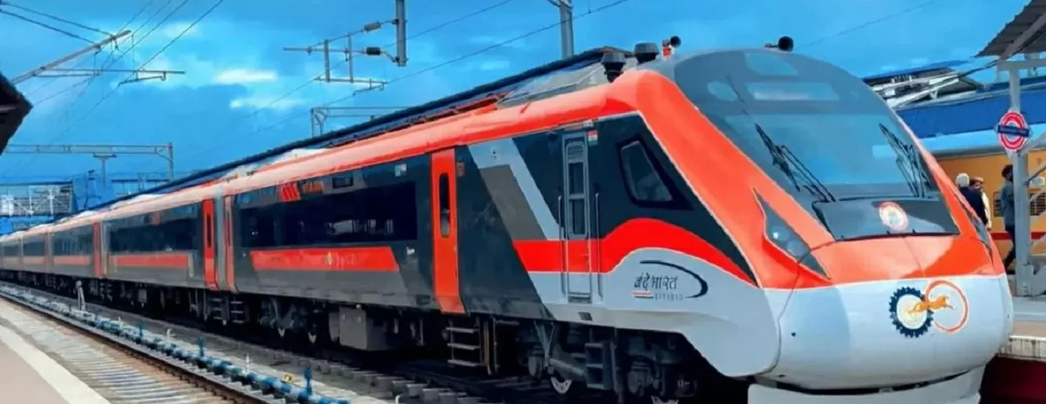
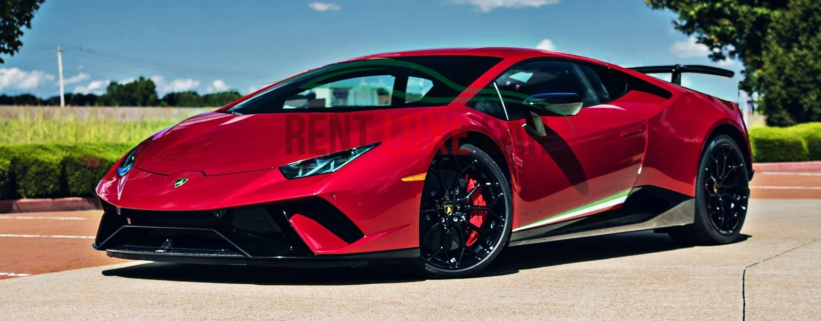
IMPORTANCE OF ENGINE
Because of engine we have working transports like airplane's, car’s , train`s etc.

Slide 6

MY THOUGHT ABOUT THE FUTURE
In the future there can be eco friendly engine`s which does not pollute the environment.

Slide 7


